Slide 1
CZ1003 – Mini Project Presentation
Done by: Sebastian, Erica, Fazirul

Slide 2
Overview
Flowchart
Data Structures
Various Techniques
Features

Slide 3
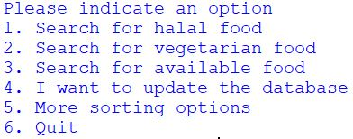
FLOWCHART
Start
List out choices for user to select from
Input choice
Is choice == ‘1’ ?

Slide 4
If choice == ‘1’
True
False
Elif choice == ‘2’
Execute program according to ‘1’
True
False
Elif choice == ‘3’
Execute program according to ‘2’
True
False

Slide 5
Input option
Choice 1: Only canteens with halal food
Choice 2: Only canteens with vegetarian food
Choice 3
Choice 4
User input food they are looking for
User input the data that needs to be changed
Only canteens with the said food choice
Update database
False(N)
Does user want to continue to sort further?

Slide 6
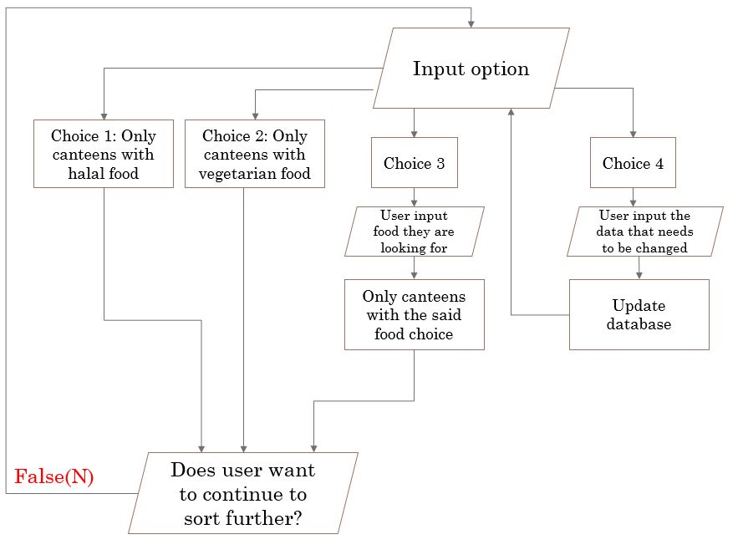
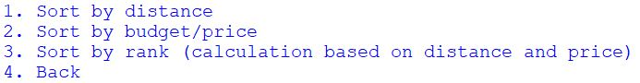
Choice 5
Choice 6
QUIT
True(Y)
Input option
Execute program based on option
END PROGRAM

Slide 7

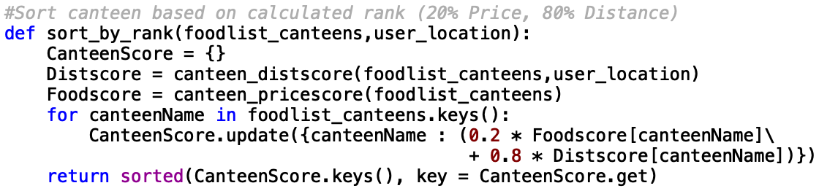
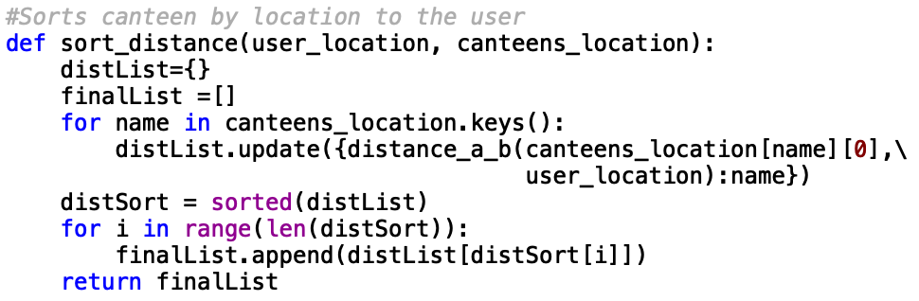
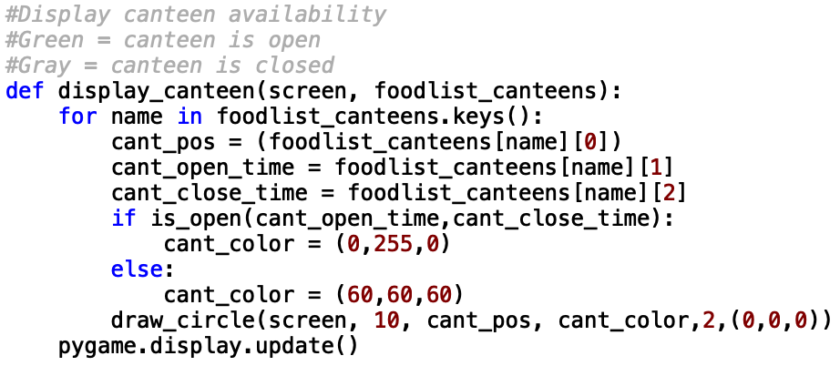
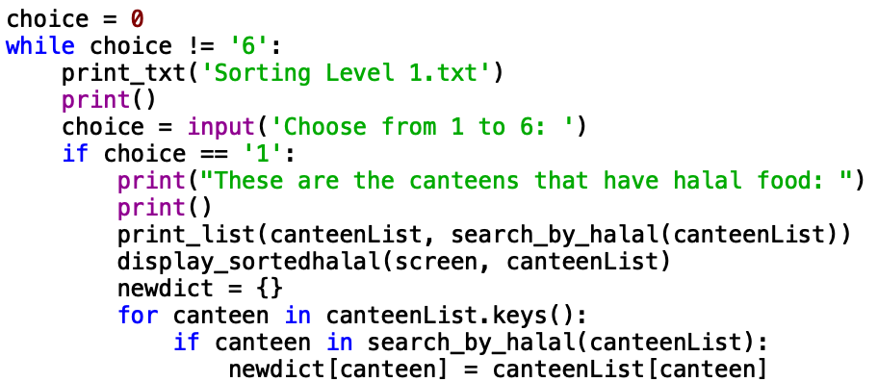
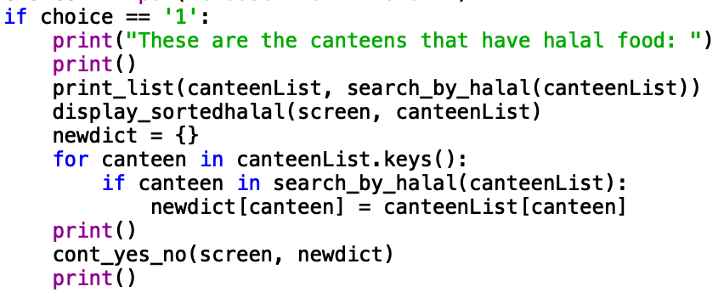
DATA STRUCTURES
Dictionaries:
Database
Rank
Sort halal, vegetarian or food type
based on distance, price or rank
Lists:
Data of food (i.e. [price, halal, vegetarian])
Sorting by distance, price, food name, halal, vegetarian
Tuples
Colour of canteen
Strings
Canteen names
Opening/closing time
Messages to user
User’s options

Slide 8
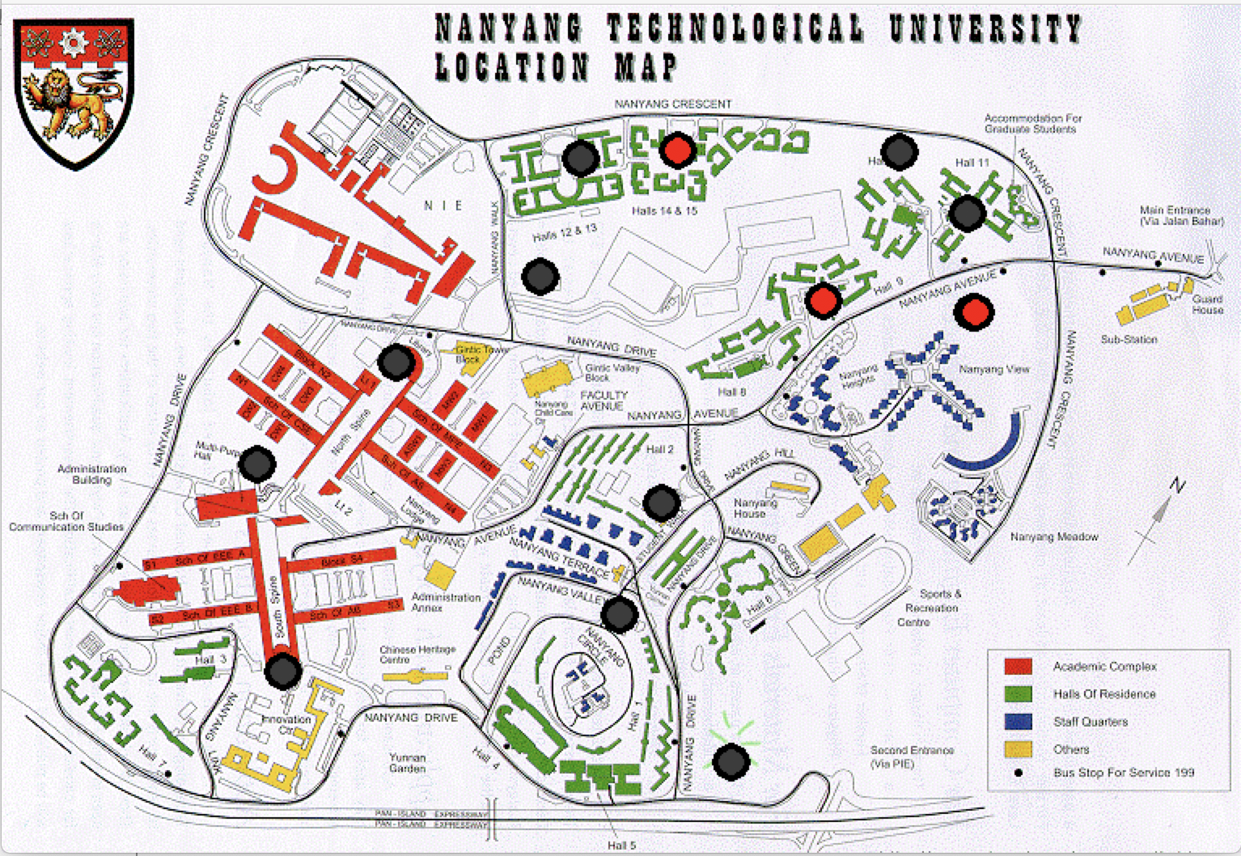
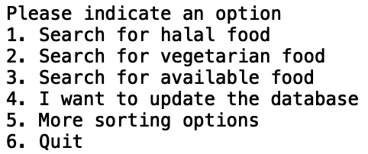
VARIOUS TECHNIQUES
Decomposition:
Information system: database.json
Display the map to user & mouseclick: pygame
User inputs inquiry and get recommendation:
Sorting Level 1.txt, Sorting Level 2.txt, Update.txt
Sort based on:
Halal, vegetarian, specific food or
Update database: Open/close time, location on map, food type
Distance, budget/price range or rank
Further enquire

Slide 9
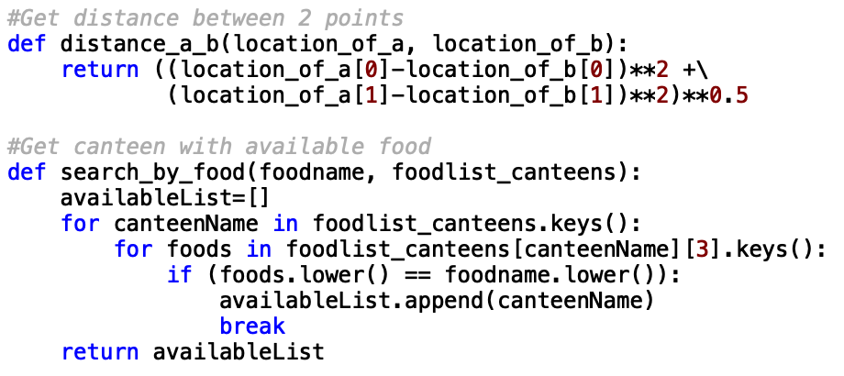
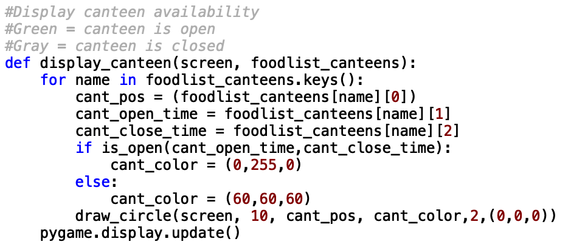
Data Abstraction
Algorithms: fuctions (e.g. Utilities.py)
In data: Dictionaries, lists, tuples, strings

Slide 10
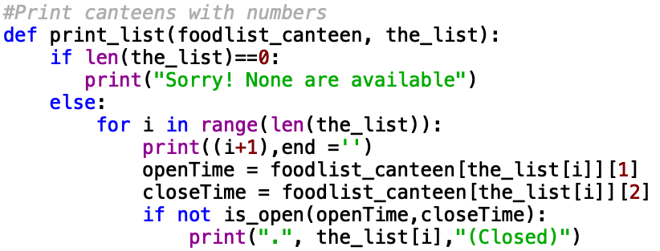
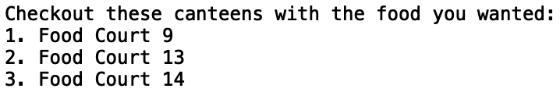

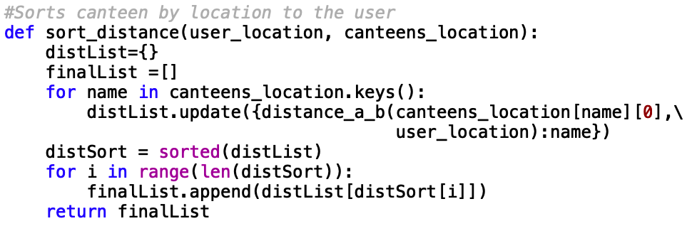
Pattern recognition: printing canteens
Algorithm design: Linear search, python’s sorted

Slide 11
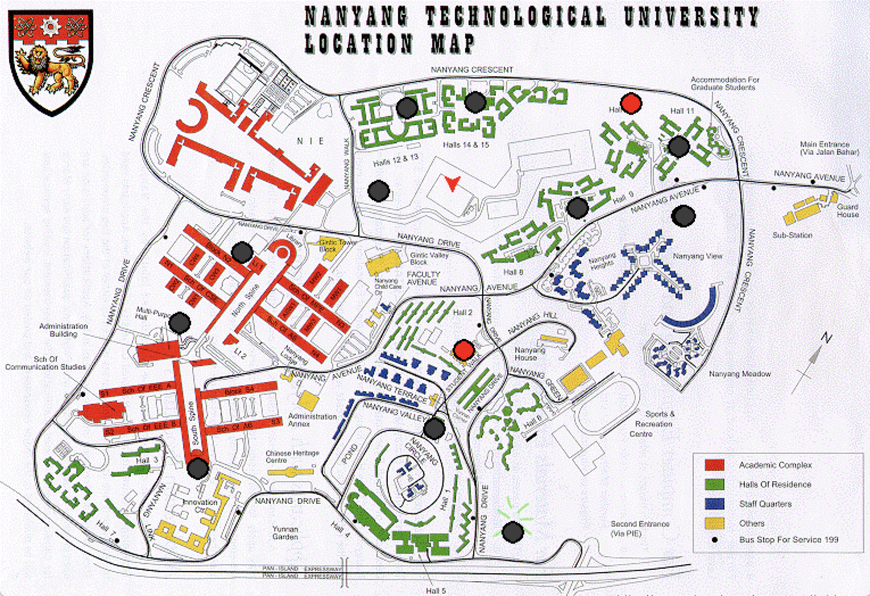
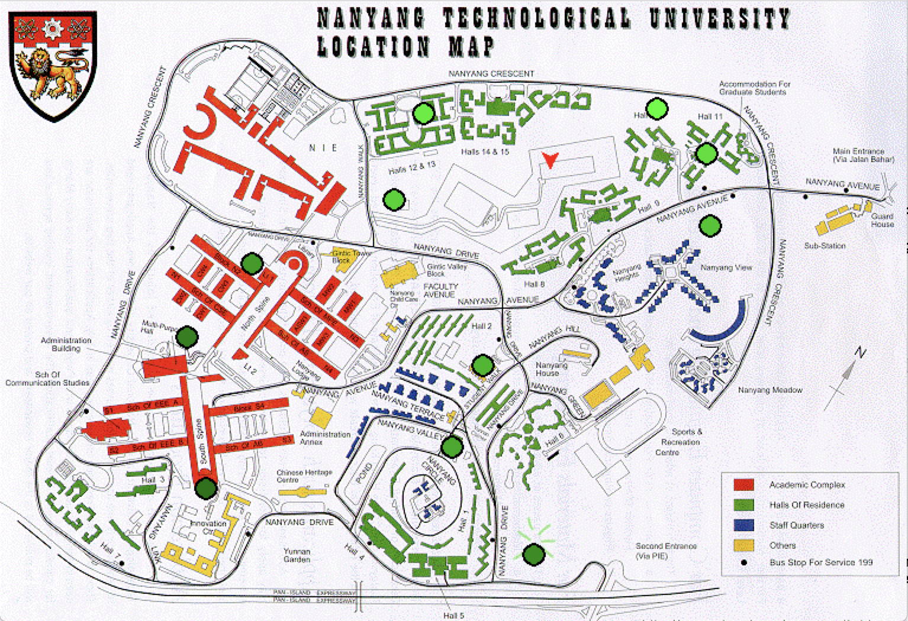
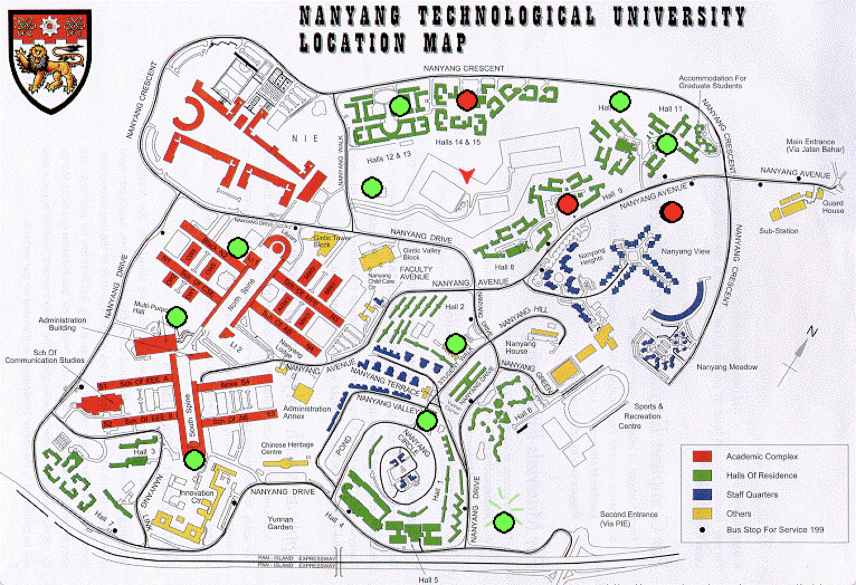
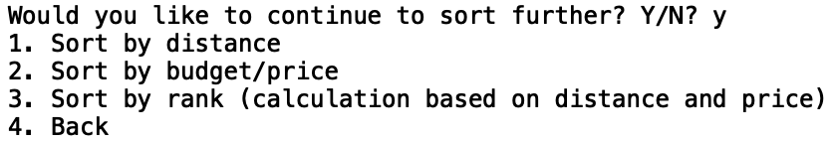
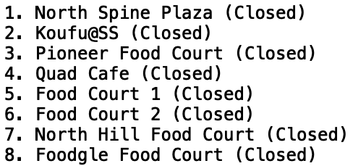
FEATURES
Display map & mouseclick
User’s position (red arrow)
Circles indicating canteen location
Canteen open (green) or closed (gray)
Canteen best (green) or worst (red)
Users can sort further the halal, vegetarian, specific food based on
Distance
Budget/price range
Rank (80% distance, 20% average price of canteen)
Informs user when the canteen is closed

